Slide 1
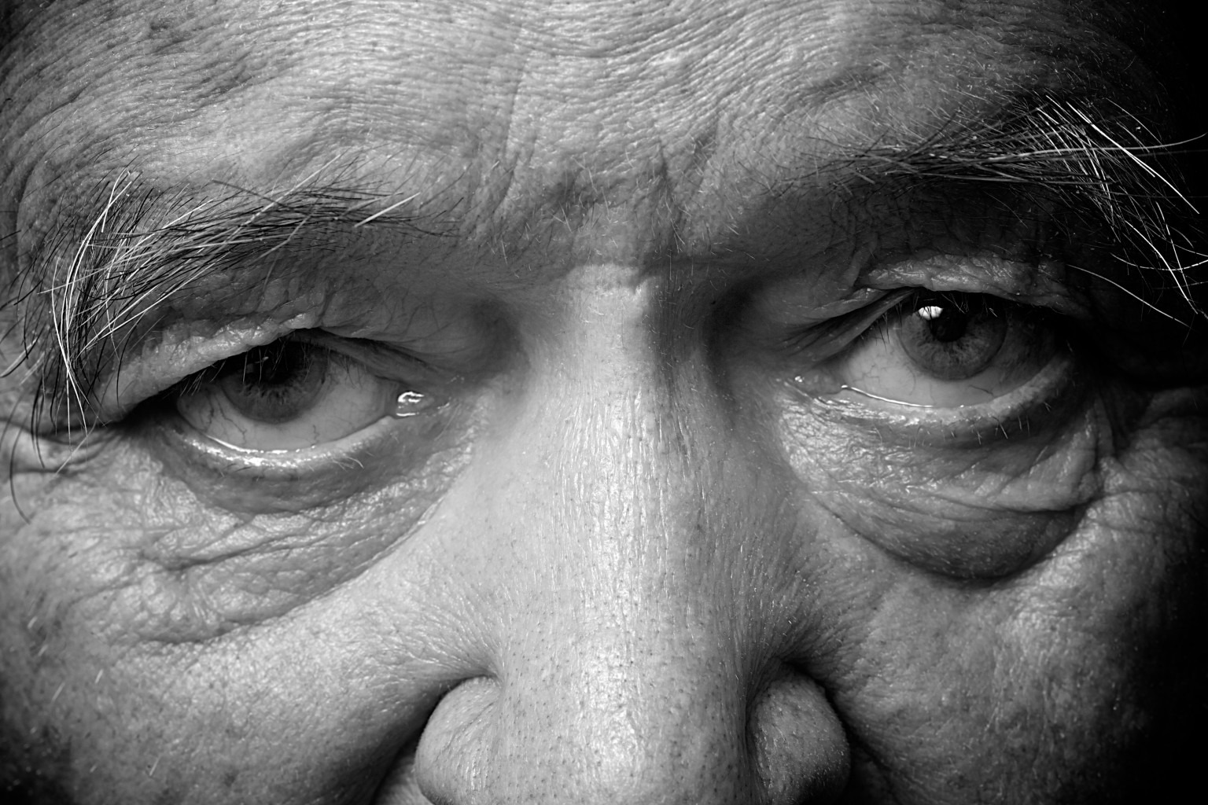
THE
PROBLEM:
ALZHEIMER’S
DISEASE
Alzheimer's disease is :
the most common form of dementia of the elderly
gets progressively worse and there is no remission
is the 6th leading cause of death in the USA
affecting more than 5 million Americans / 30 million worldwide
is the only cause of death among the top 10 in America that cannot be prevented, cured or even slowed.

Slide 2
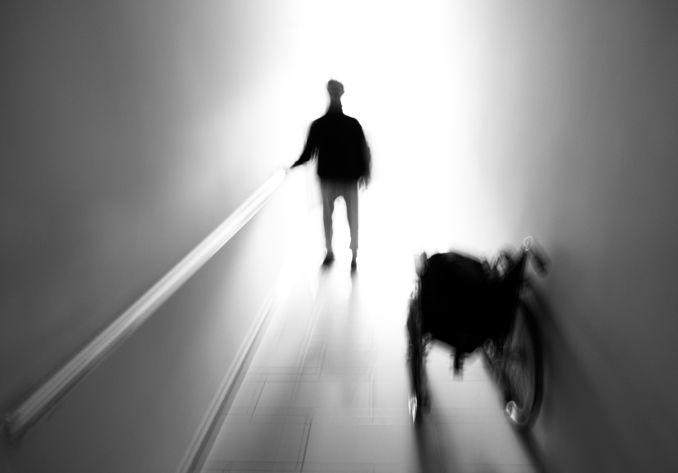
IT IS
DEVASTATING
Alzheimer's Disease is
associated with:
memory loss
confusion
aphasia
loss of executive function
personality change
occasionally with paranoia, aggression and hallucinations

Slide 3
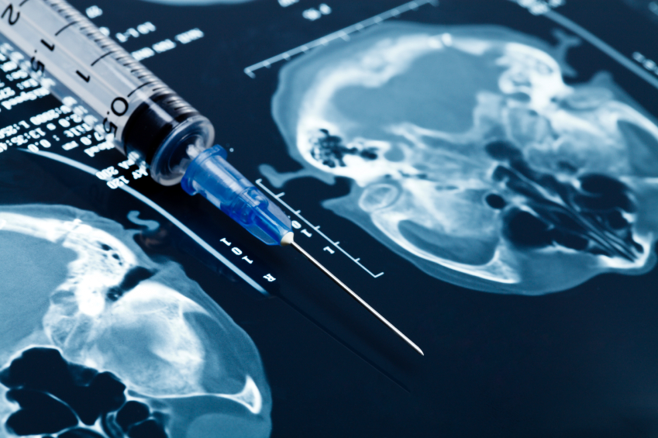
FINDING A
CURE:
WHAT WE
KNOW
The cause of Alzheimer's Disease is unknown but it is characterized by plaques and tangles in the brain, found near/ within degenerating neurons. These lesions can now be detected by appropriate brain PET scans in live patients.
Aiming to remove or reduce those lesions is a strategy employed by drug developers, but so far all efforts failed, either because of safety or efficacy issues

Slide 4
NEUROTEZ:
A PROMISING
SOLUTION
Many studies in disease models have shown that leptin is neuroprotective, improves cognition and is accompanied by a decrease in levels of both phospho-tau/tau and beta amyloid (Aβ), the factors linked to the lesions in Alzheimer’s disease pathology.
Because leptin is a naturally occuring hormone and is at low levels in Alzheimer’s patients, leptin replacement therapy represents a relatively de-risked multi-functional therapeutic approach.

Slide 5
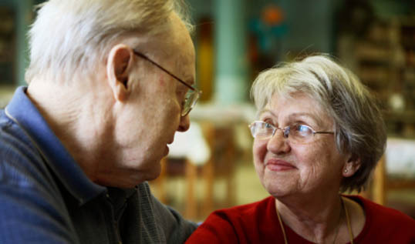
Management team:
Nikolaos Tezapsidis, PhD
J Wes Ashford, MD, PhD
George Perry, PhD
Eugene Oliva, MBA
Jane Johnston, PhD
Steven Greco, PhD
Directors:
Nikolaos Tezapsidis, PhD
George Perry, PhD
Eugene Oliva, MBA
James Harris, MBA
Jeff Swarz, PhD
Haro Hartounian, PhD
J Wes Ashford, MD, PhD
Advisors:
Arthur Klausner, MBA
Lex Van der Ploeg, PhD
Steve Jacobsen, PhD
Gilbert Block, MD, PhD
Lawrence Friedhoff, MD, PhD
Daniel Van Kammen, MD, PhD
Kent Iverson, BS
Contact:
Nikolaos Tezapsidis
President & CEO
Neurotez, Inc.
991 Highway 22, Suite 200A,
Bridgewater, NJ 08807, USA
Tel:+1-908-998-1340
Fax: +1-908-864-8957
ntezapsidis@neurotez.com

